Slide 1

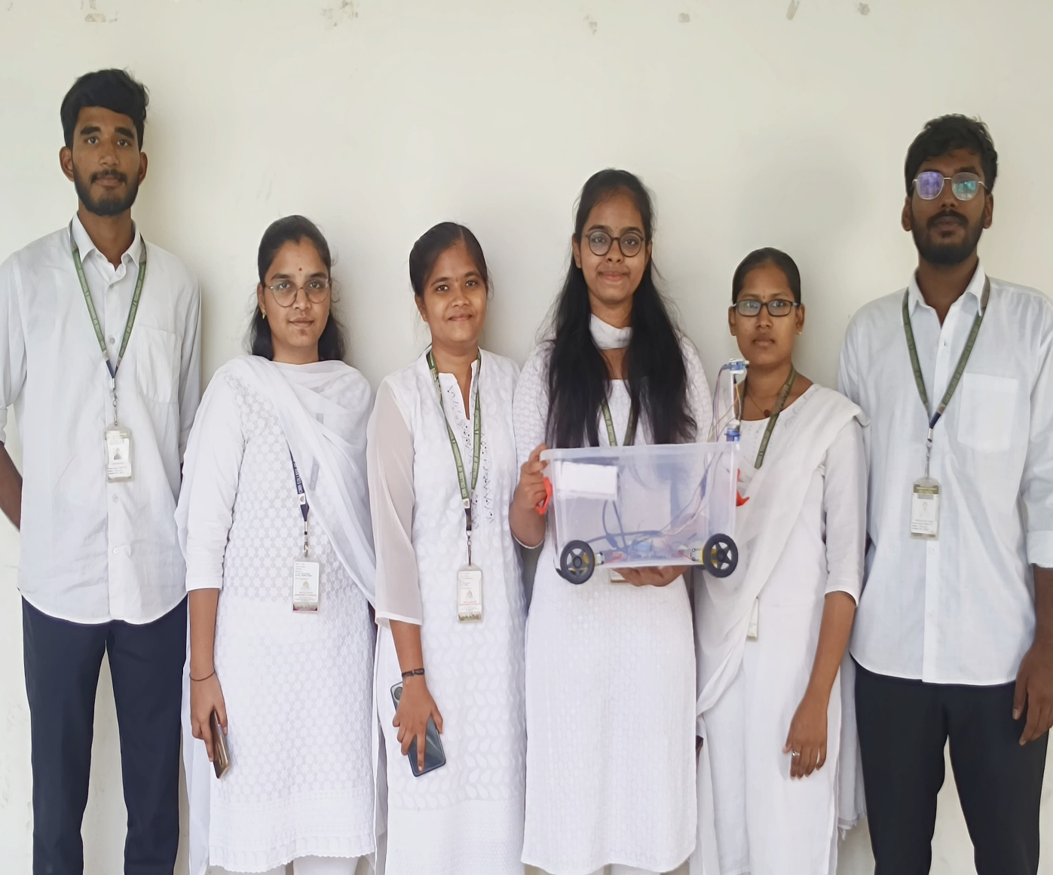
CMR College of Engineering & Technology
(UGC Autonomous)
Kandlakoya , Medchal Road, Hyderabad 501401
Centre for Engineering Education Research (CEER) SOCIAL INNOVATION IN PRACTICE
A.Y 2024-25 IV SEMESTER
AUTO SHOP CART
Team Details Faculty Coordinators
J. NIKITHA - 22H51A0485
B. SIRI CHOWDARY - 23H51A0410
M. PUSHPA LATHA - 23H51A0434
K. SAHASRA - 23H51A04E2
T. VARUN KUMAR - 23H51A04H4
G. SRUJAN REDDY -23H51A04Q6
1. Mr.B. Suresh Ram, HOD CEER
2 . K.Raju, Asst. Professor,CEER ECE
3 . Mr.S.Suresh Asst Pofessor,CEER IT
4 . Mr. P. Senthil, Asst Professor,CEER CSM
EXISTING SYSTEMS
Project Objective
Standard Shopping Trolley
Foldable & Compact Trolley
Specialty & Custom Trolleys Child-friendly Carts
Smart human following shopping trolleys are designed to follow customers automatically, eliminating the need for them to push the cart manually and also bills automatically without any billing person.
 |  | User requirement
 |  | It should be interactive and be useful for cognitive development. It should be useful for day to day activities and should be helpful for everyone.
Issue
Shopping malls are one of the most popular places for leisure activities, shopping, and entertainment, which attract a large number of people every day. With the increasing popularity of online shopping, stores have faced challenges to retain customers. As a result, shopping malls have been looking for innovative ways to provide more personalized shopping experience to attract and retain customers. One such solution is smart human following shopping trolleys.
 |  | Gaps in the existing system
 |  | Inaccurate Scanning & Checkout issues. High Cost & Maintenance. Limited Navigation & User Assistance. Theft Prevention Challenges. Limited Adaptability to Different Shopping Environments. Short Battery Life &Charging Infrastructure.
Methodology
 | The methodology of an Auto Shop Cart involves designing and planning the cart to meet specific requirements, selecting durable materials, manufacturing and deploying and maintaining the cart. Key considerations include mobility, storage capacity, and durability to ensure the cart can withstand the demands of the auto shop environment and improve efficiency and productivity. By following this methodology, an Auto Shop Cart can be built to meet the unique needs of the shop, providing a practical and effective solution for storing and transporting tools and equipment.

